Slide 1
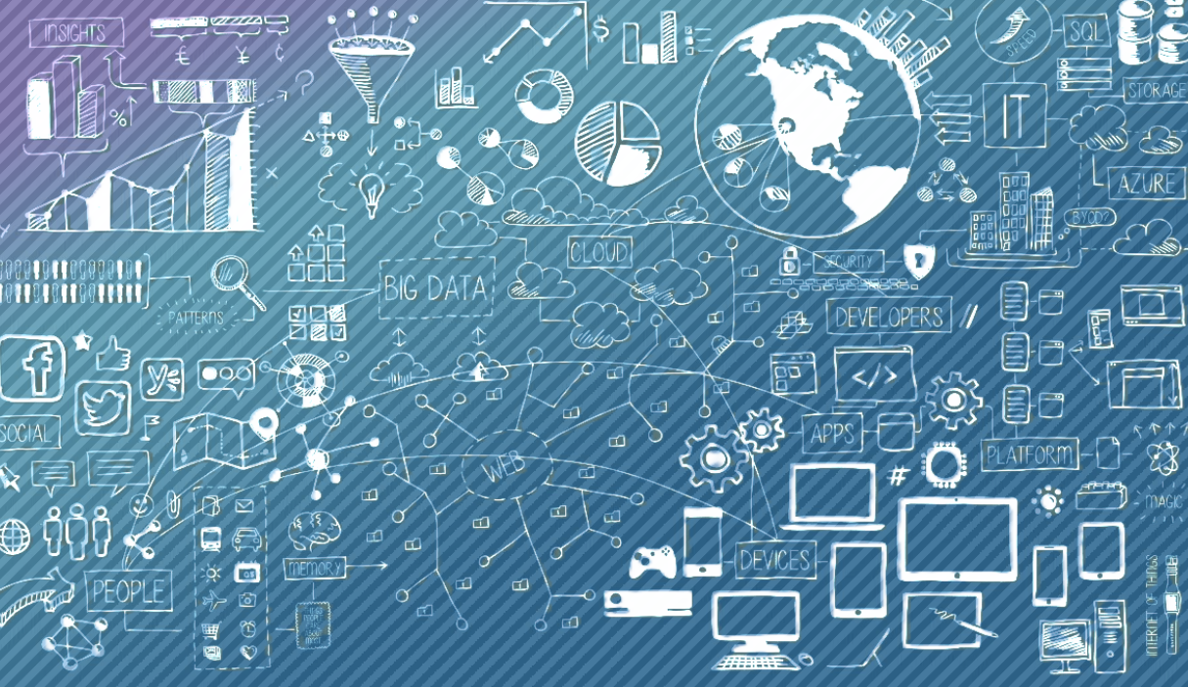

Department of Data Science
II B.Tech II Semester MiniProject-2024
Submitted by Batch - 07
WEB DATA EXTRACTION FROM WEBSITES
TEAM MEMBERS | ROLL NUMBERS
K.VENKATA ADITHYA (Team Lead) | 22R21A6792
K. Purna Vamsi | 22R21A6787
B.VARUN | 22R21A6768
Under the Guidance :
Mrs.K.Srinija
Department of Data Science

Slide 2

CONTENTS
Abstract
Introduction
Existing System
Drawbacks
Proposed System
Objectives
Advantages
Architecture
Module Diagrams
Implementation
Result
Conclusion
References

Slide 3
ABSTRACT
Web scraping, a dynamic technique, has emerged as an indispensable tool for gathering structured information from websites and online sources. Web scraping encompasses a wide range of automated data extraction methods that enable users to access and collect data from websites and web applications. These techniques involve parsing the HTML, XML, or other structured data formats of web pages to extract specific information, such as text, images, links, and more. Web scraping plays a pivotal role in the digital age, offering unprecedented access to valuable data for research, business, and decision-making purposes. As the digital frontier continues to expand, web scraping remains a powerful tool for unlocking insights and opportunities from the vast online ecosystem. Web scraping should be conducted ethically and within legal boundaries. Some websites explicitly prohibit web scraping in their terms of service and scraping sensitive or personal data without consent is illegal in many jurisdictions. Web scraping is a powerful tool for collecting and utilizing data from the web.

Slide 4
INTRODUCTION
WEB DATA EXTRACTION FROM WEBSITE
Web scraping is a technique to fetch data from websites. While surfing on the web, many websites don’t allow the user to save data for personal use. One way is to manually copy-paste the data, which is both tedious and time-consuming. Web Scraping is the automation of the data extraction process from websites. This event is done with the help of web scraping software known as web scrapers. They automatically load and extract data from the websites based on user requirements. These can be custom-built to work for one site or can be configured to work with any website.

Slide 5
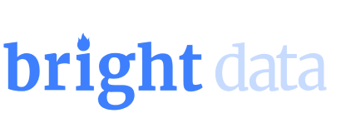
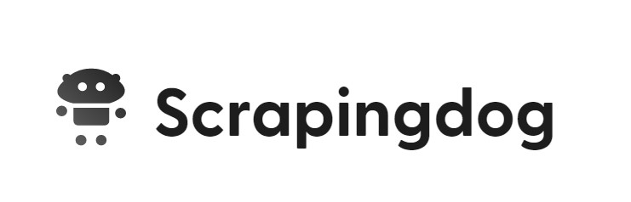

Existing System
Bright Data:
Bright Data provides fully compliant and risk-free access to robust data. With its customizable dashboard and the capability to structure data sets of any size
Scrapingdog:
Designed to lend easy web scraping to developers and non-developers alike
AvesAPI:
AvesAPI provides a highly focused extraction of structured data from Google Search

Slide 6
Drawbacks
Legal and Ethical Issues: Scraping data can infringe on copyrights and terms of service, leading to legal consequences.
Data Quality and Reliability: Scraped data may be unstructured, inaccurate, or outdated, requiring significant cleaning and verification.
Technical Challenges: Websites often implement anti-scraping measures, which can make scraping difficult or impossible without advanced techniques.

Slide 7
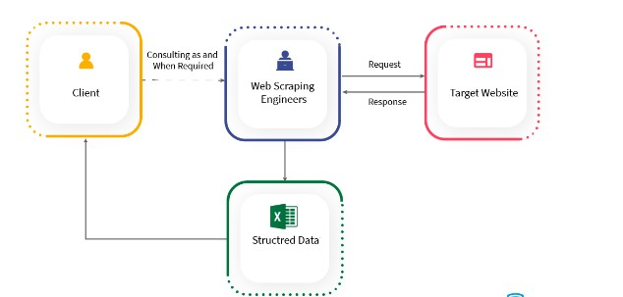
Proposed System
Data Collection
Data Processing
Target Websites
Scalability Error
Handling and Logging

Slide 8
Objectives
Monitoring price and its fluctuations in set fields like real estate and getting that data.
Extract news and articles from various sites and efficiently, gather news content for analysis or reading and Monitor multiple sources simultaneously.
Monitor changes on a specific website and track product releases and news. Receive timely notifications about relevant website modifications. Keep up-to-date without manual checking.
Obtaining large datasets scraping allows organizations to collect vast amounts of data from websites, which can be used for various purposes such as market research, analysis, and decision-making.
Extract information from public records available on websites to gather data related to individuals, businesses, or government activities .Streamline the process of obtaining public information.

Slide 9
Advantages
Achieve Automation
Business Intelligence & Insights
Unique and Rich Datasets
Create Applications Without Public APIs

Slide 10
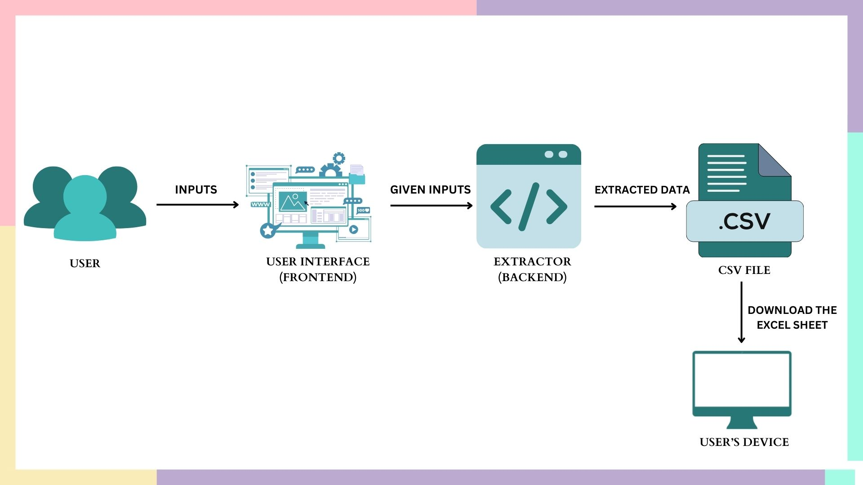
Architecture

Slide 11
The proposed system consists of two modules as mentioned in the above diagram.
• User Interface
• Extractor
USER INTERFACE: The functions in the user interface module include users giving the required inputs. Once the user gives the required input, the inputs are passed to the extractor to begin the extraction. This module allows the users to give input and and then as output the excel file containing the extracted data is downloaded into the user’s device.
EXTRACTOR: The csv modules is used to store the csv file temporarily which contains the required data and downloads that csv file as an excel sheet into the user’s device.
Modules

Slide 12
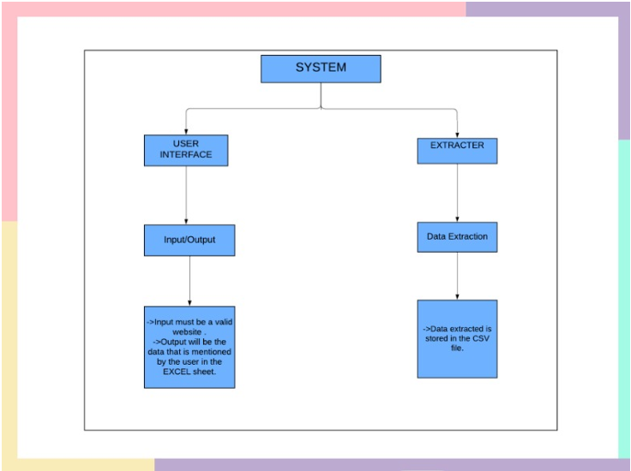
Modules

Slide 13
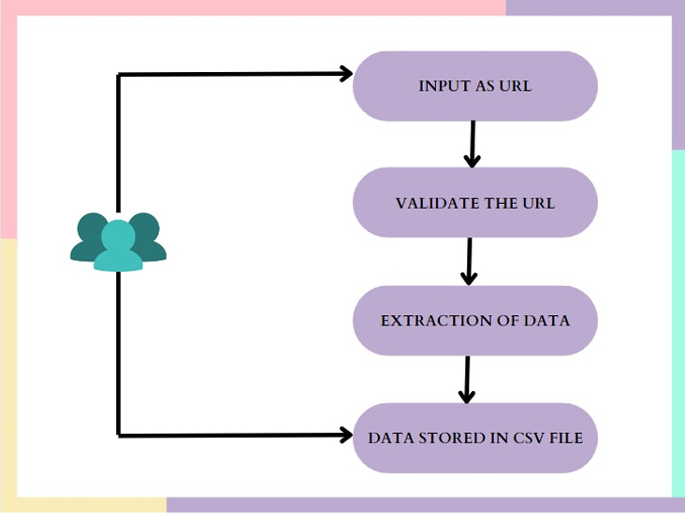
Use Case Diagram

Slide 14
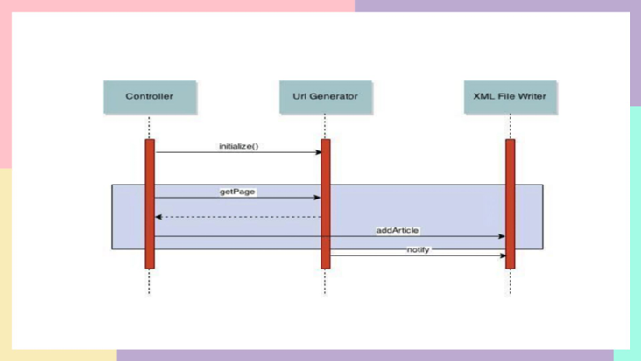
Sequence Diagram

Slide 15
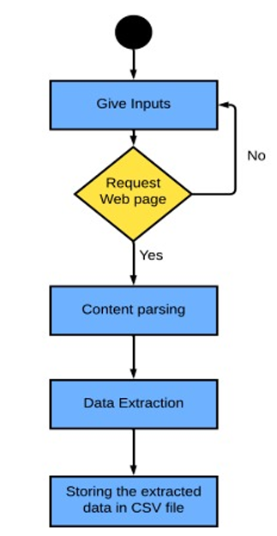
Activity Diagram

Slide 16
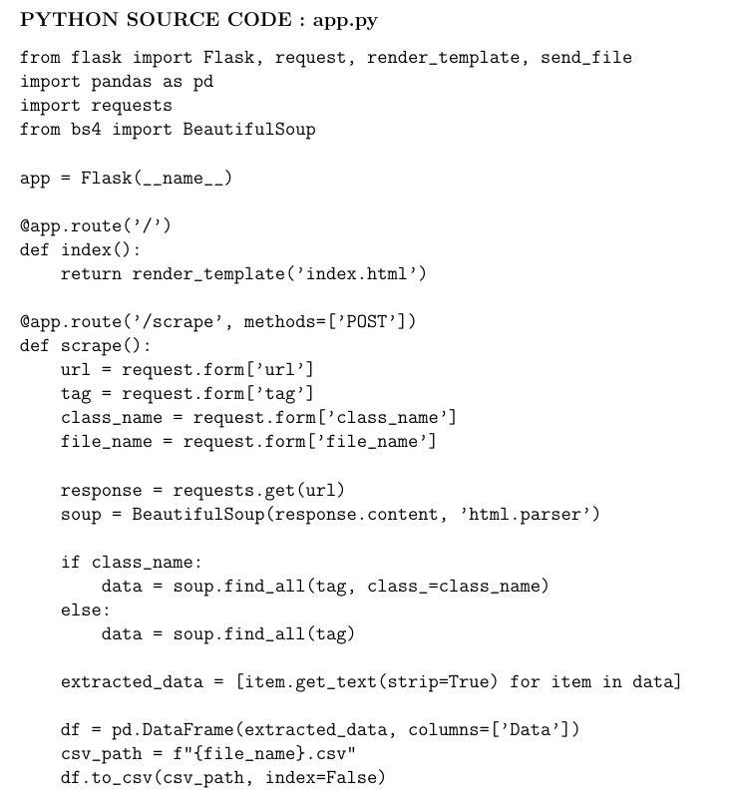
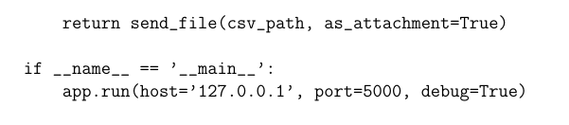
Implementation

Slide 17
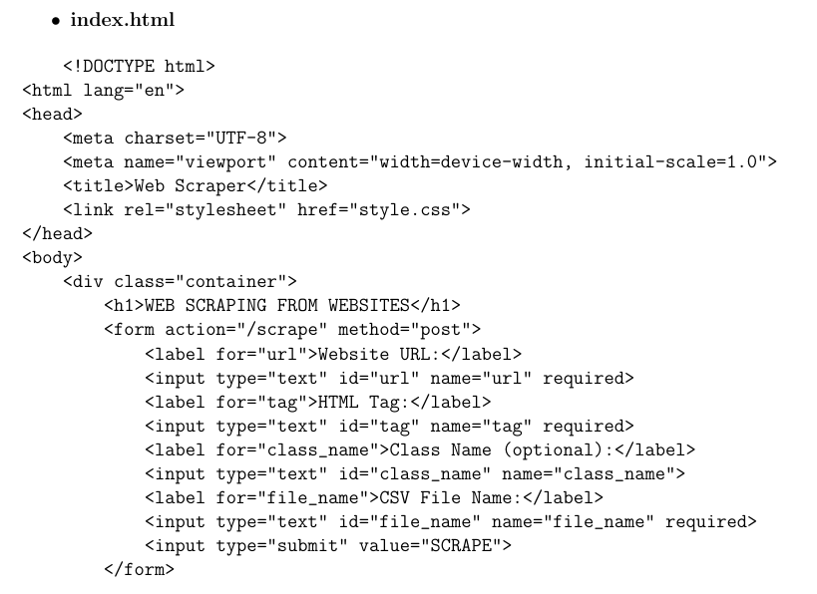
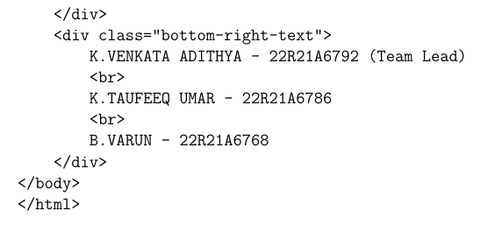
Implementation

Slide 18
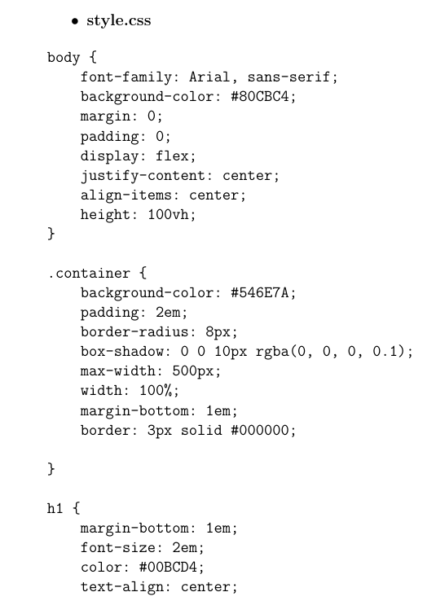
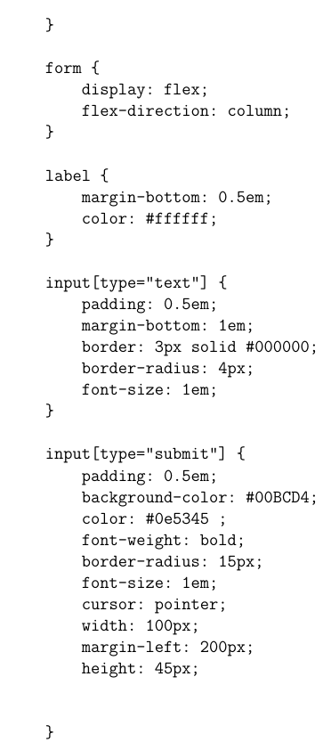
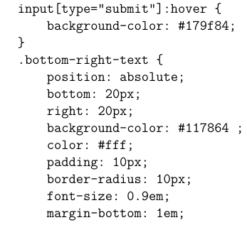
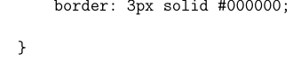
Implementation

Slide 19
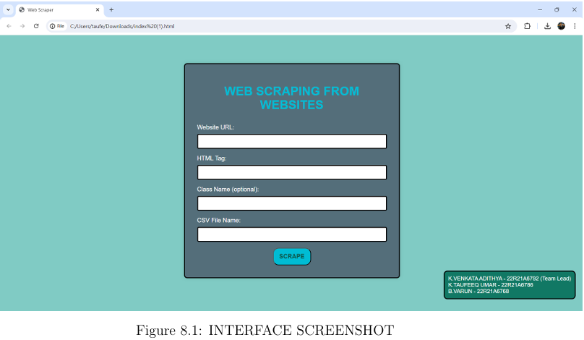
Results

Slide 20
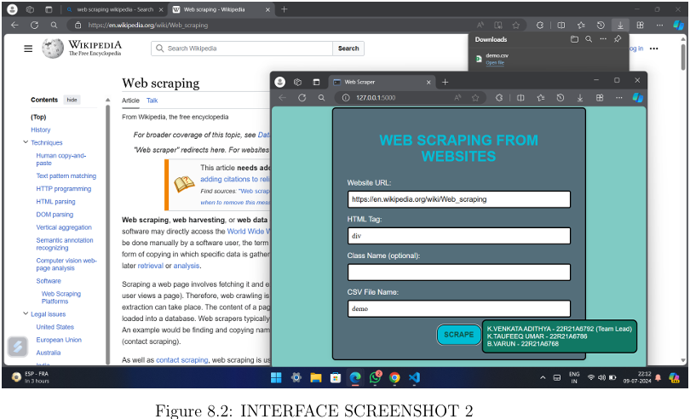
Results

Slide 21
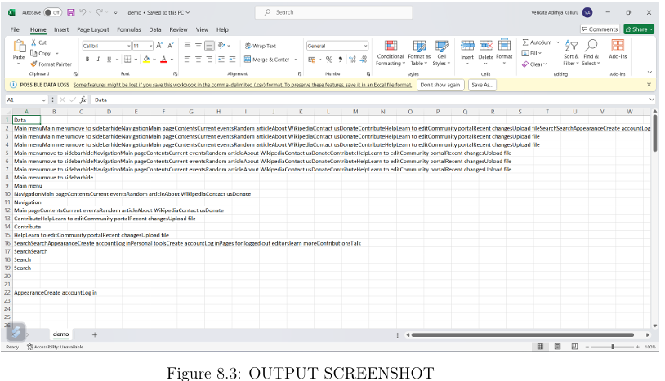
Results

Slide 22
Conclusion
web data extraction as a tool for information gathering, focusing on ethical practices and accessibility. By using the right methods and staying small-scale, we've shown how this technique can be effective for personal use and research without breaking the bank. By following legal and ethical guidelines, we've promoted responsible data collection and use, ensuring these valuable online resources stay available for everyone. web data extraction will undoubtedly play a more and more important role in various professional and academic fields.

Slide 23
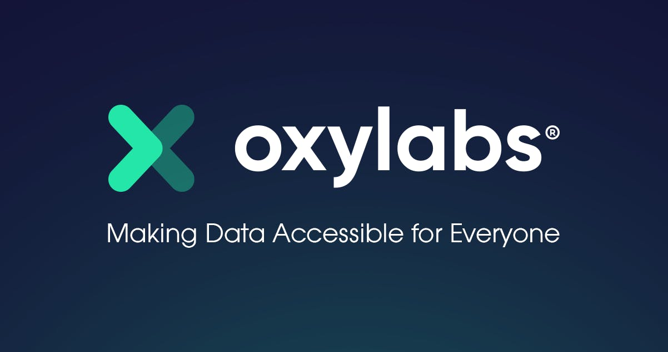

References
Oxylabs - https://oxylabs.io/blog/python-web-scraping
Wikipedia - https://en.wikipedia.org/wiki/Web_scraping

Slide 24
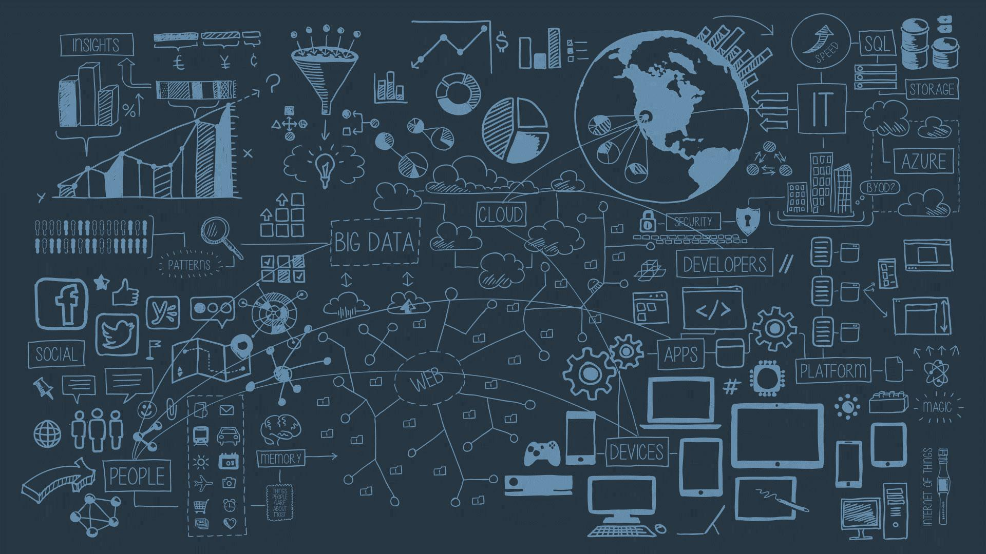
THANK YOU

